Slide 1
Introductory Class

Slide 2
Contents
Class Introduction
Course Description
Course Introduction
Chapter-1

Slide 3
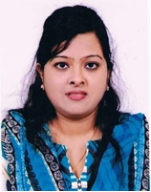
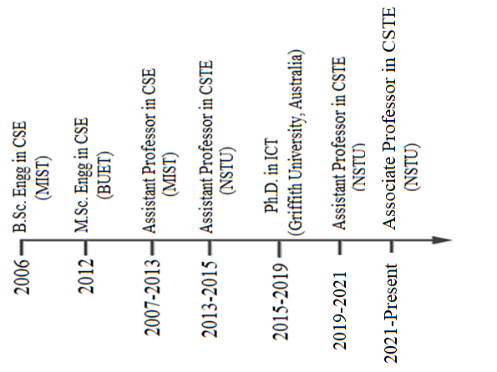
Dr. Nazia Majadi
Teaching & Research:
Previous teaching experience in MIST & NSTU:
Programming courses, TOC, Compilers, Database Systems, Machine Learning
Previous teaching experience in Griffith University, Australia:
Business Informatics,
Database Design/Data Management
Research interests:
Healthcare in AI
Machine learning and analytics
eCommerce Security
My academic timeline:
Contact info:
Email: nazia_majadi@nstu.edu.bd

Slide 4
Class Introduction Course Name: Theory of Computation (TOC)
Course Code: CSTE 2107

Slide 5
Course Description
Credit hours: 3.0
Textbook(s)
Introduction to Automata Theory, Languages, and Computation (3rd Edition)
Authors: John E. Hopcroft, Rajeev Motwani, and Jeffrey D. Ullman
Resources:
Textbook(s)
Class lectures/slides
Exercises provided in your textbook(s)
Class schedule:
Monday (12:00-12:50pm), Tuesday (10:00-10:50am), and Wednesday (03:00-03:50pm)
Classroom code: jbvppnc

Slide 6
Automata: The Methods and The Madness
Chapter-1

Slide 7
Contents
What is automata?
Why should you study Automata theory?
Historical Perspective of TOC
Layers of Automata theory
Importance of TOC
Real-world applications
Computational model

Slide 8

What is Automata? Why should you study Automata Theory? Why is Automata Theory important in CS?

Slide 9
Human
A machine that
Recognizes one/multiple languages
Performs useful work when given instructions in the recognized language(s)
Has a capability of processing the instructions/input to
Solve a set of problems [NOT ALL Problems]

Slide 10
Human Capabilities
To judge the capabilities of humans (in general) with respect to:
What problems can be solved by humans?
Can not experiments with all humans…
We would like to develop an abstract model of humans
Processing Model (Abstract Machine) [IPO]
A set of problems

Slide 11
Problems solvable by Humans
Recognition of a Language
A Problem (itself)
Hence
Language = Problem ☺
Is language ‘x’ recognizable by the machine?
Is problem ‘x’ solvable by the machine?
We (in this course) will focus mainly on this simple Problem (w.r.t Computers)

Slide 12
Theory of Computation
What can be computed & what can not be
Computability Theory
What makes some problems computationally hard & others easy?
Complexity Theory
How does a computer made to think?
‘abstract mathematical model’ of computers
Automata Theory

Slide 13
Theory of Computation
TOC is the branch that deals with how efficiently problems can be solved on a Model of Computation, using an Algorithm.
The field is divided into three major branches:
Automata theory and language: It deals with the definition and properties of various mathematical model of computers (e.g., finite automata, context free grammar, turing machine)
Computability theory: It deals with what can & cannot be computed by the model, and
Computational Complexity Theory [Efficiency]: It groups the computable problem based on their hardness (e.g., NP hard problem).
Which are linked by the question: “What are the fundamental capabilities and limitations of computers?”

Slide 14
Theory of Computation- Terms
A model of computation is the definition of the set of allowable operations used in computation and their respective costs.
What is Algorithm???
Automata Theory is the study of Abstract Machines and Automata [Self Acting Machine]
Automaton = an abstract computing device
Note: A “device” need not even be a physical hardware!
Formal Language: recognized by an automaton

Slide 15
What is Automata Theory?
Study of abstract computing devices, or “machines”
Automaton = an abstract computing device
Note: A “device” need not even be a physical hardware!
A fundamental question in computer science:
Find out what different models of machines can do and cannot do
The theory of computation
The main purpose of TOC is to develop formal mathematical model of computation that reflect real world computers.

Slide 16
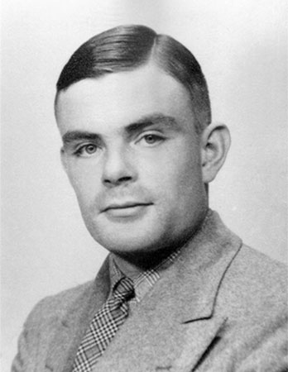
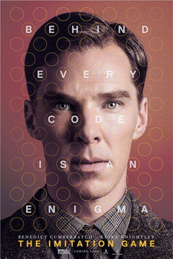
A pioneer of TOC
Alan Turing (1912-1954)
Father of computer science
English logician
Propose
Turing machine as a mathematical model of computation
Codebreaker for German Enigma machine in World War II
Many other pioneering work, e. g., Turing test
A function on the natural numbers can be calculated by an effective method if and only if it is computable by a Turing machine.

Slide 17
Historical Perspective of TOC
1930s | Alan Turing studies Turing machines Decidability Halting problem, Alan Turing proved that there are computations that can never be done (no matter how big and fast computers get).
1940-1950s | “Finite automata” machines studied Noam Chomsky begun study of formal grammar and proposes the “Chomsky Hierarchy” for formal languages
1969 | Cook introduces “intractable” problems or “NP-Hard” problems
1970- | Modern computer science: compilers, computational & complexity theory evolve

Slide 18
Importance of TOC
An important part of the core of computer science.
Introduction to Finite Automata
Structural Representation
Automata and Complexity

Slide 19
Importance of TOC (contd…)
Introduction to Finite Automata
Software for designing and checking the behavior of digital circuits
The “Lexical analyzer” of a typical compiler , that is , the compiler component that breaks the input text into logical units, such as identifiers, keywords, and punctuation.
Software for scanning large bodies of text, such as collections of Web pages, to find occurrences of words, phrases, or other patterns.
Software for verifying systems of all types that have a finite number of distinct states, such as communications protocols or protocols for secure exchange of information.

Slide 20
Importance of TOC (contd…)
Examples of Finite Automata
Push
Start
Start
t
h
e
n
off
on
t
th
the
then
Push
Example 1: An On/Off Switch
Example 2: Recognition of then

Slide 21
Importance of TOC (contd…)
Structural Representation
There are two important notations there are not automation-like, but play an important role in the study of automata and their applications
Grammars are useful models when software that processes data with a recursive structure.
Regular Expressions are denoted the structure of data, especially text strings.
Example: “Palo Alto CA”:
[A-Z][a-z]*([ ][A-Z][a-z]*)*[ ][A-Z][A-Z]
Start with a letter
A string of other letters (possibly empty)
Other space delimited words (part of city name)
Should end w/ 2-letter state code

Slide 22
Importance of TOC (contd…)
Automata and Complexity
Automata are essential for the study of the limits of computation. There are two important issues.
What can a computer do at all? This study is called “decidability”, and the problems that can be solved by computer are called “decidable.”.
What can a computer do efficiently? This study is called “intractability,” and the problems that can be solved by a computer using no more time than some slowly growing function of the size of the input are called ”tractable.”

Slide 23
Example of TOC
Automatic photo printing machine
Artificial card punching machine
Vending machine
Traffic Lights
Video games
Text parsing
Regular expression matching
Speech recognition

Slide 24
Real-world applications of TOC
They are use in Artificial Intelligence, Embedded System, Formal Verification etc.
But the most widely used application is in Compiler Construction. They check whether the language written is correct or not.
Consider you are programming in C language. So what are all the symbols you type in programming………they are a set consisting of {a,b,c….z,A,B,C……Z, + , - ,$,….etc.} that is a set of “Finite” alphabets. Now you wrote a program as
In C it is a program but in TOC it is string and C is basically a set of all Valid program,which indeed is an Infinite set. So a program you are writing is correct if it is in that “Infinite” set of correct C program,which is impossible to create and linearly search for. So TOC works such that given a Language ,say C language,it work on a Finite Representation which can be stored in memory which takes the string,that is your program, and decide whether its a valid C program or not. And these Finite representation are all the rules which we follow to write a program. Say it checks whether the number of open brackets ‘ { ‘ are equal to the number of close bracket ‘ } ‘.
#include<studio.h>
void main(){
int a,b;
…
….}

Slide 25
Current research on TOC
The main areas of research are
computability, which is concerned with the question "what is computable?", and
computational complexity, which is concerned with the question "what is efficiently computable?".

Slide 26
Computational Model

Slide 27
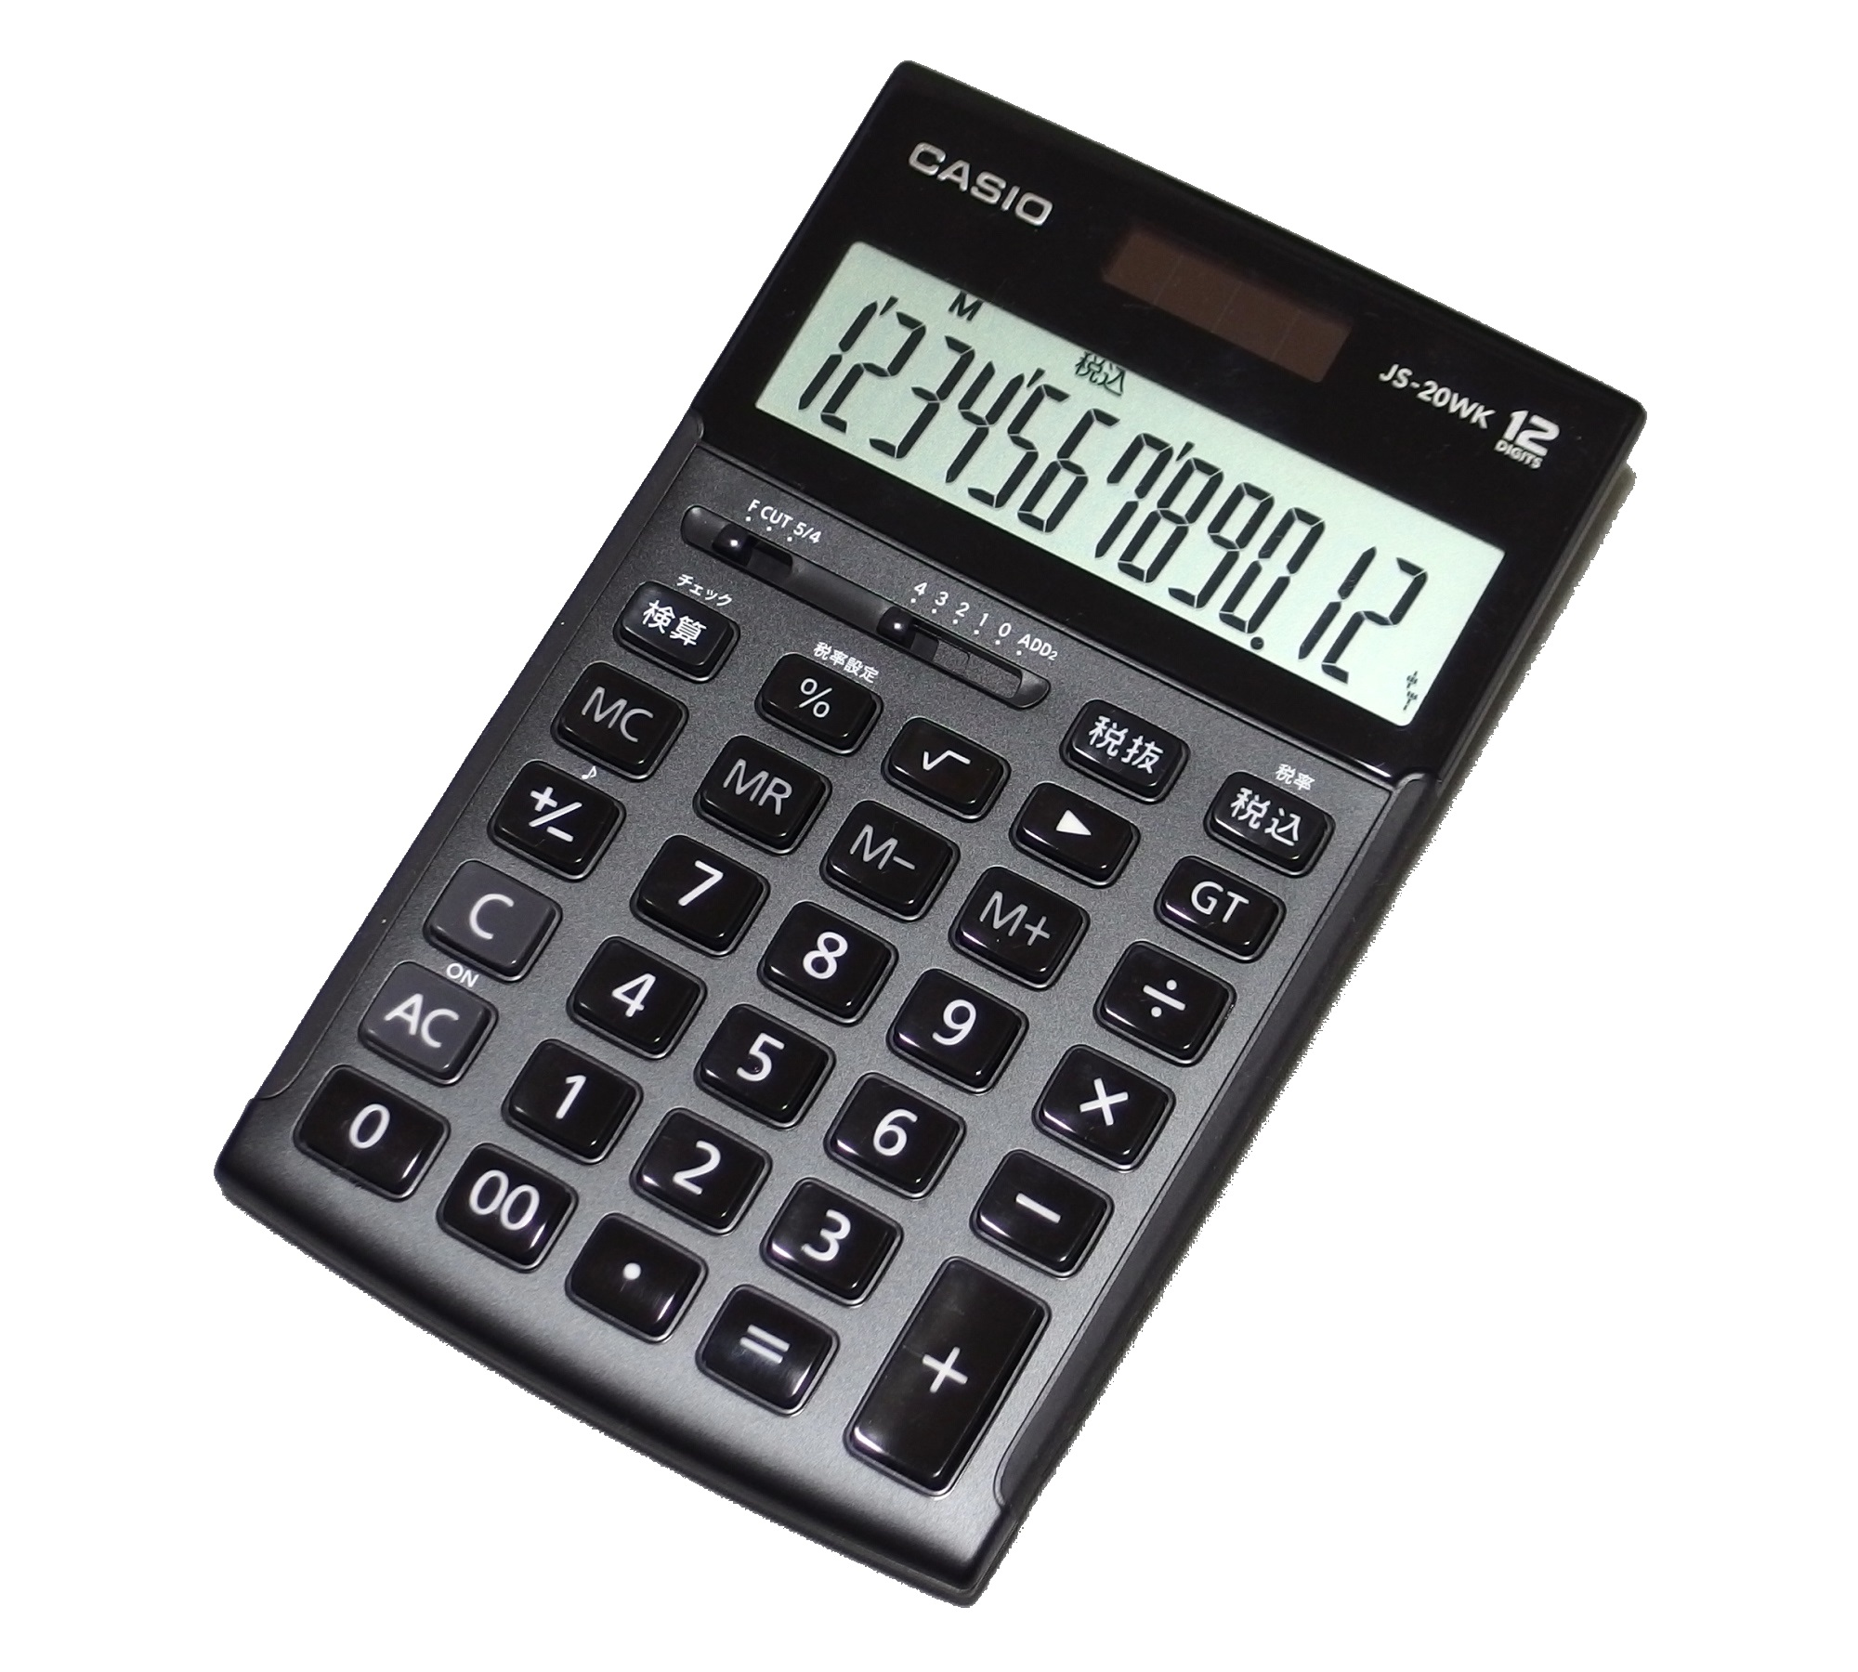
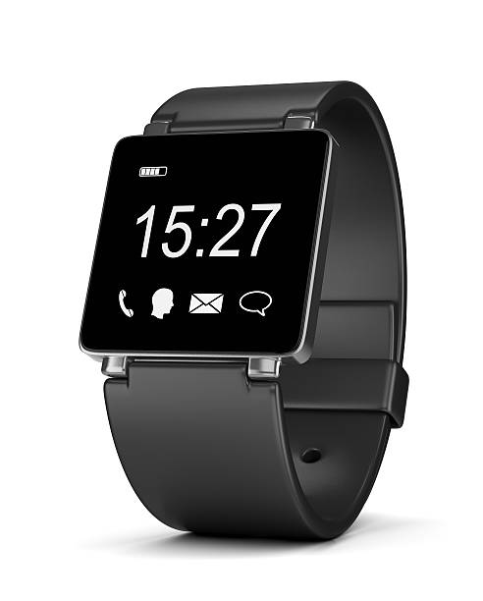


Slide 28
Layers of Automata Theory (Chomsky Hierarchy)
Turing Machine
Linear bounded automata
Pushdown automata
FSM

Slide 29
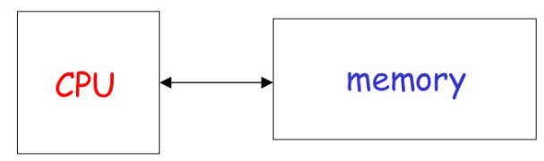
A widely accepted model of computation

Slide 30
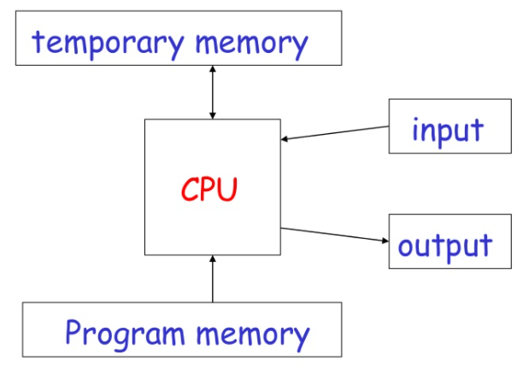
The different components

Slide 31
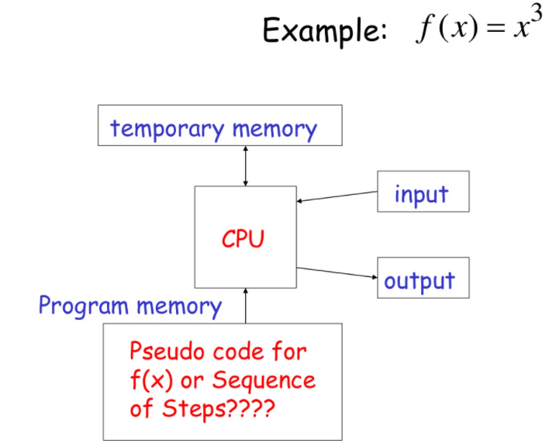

Slide 32
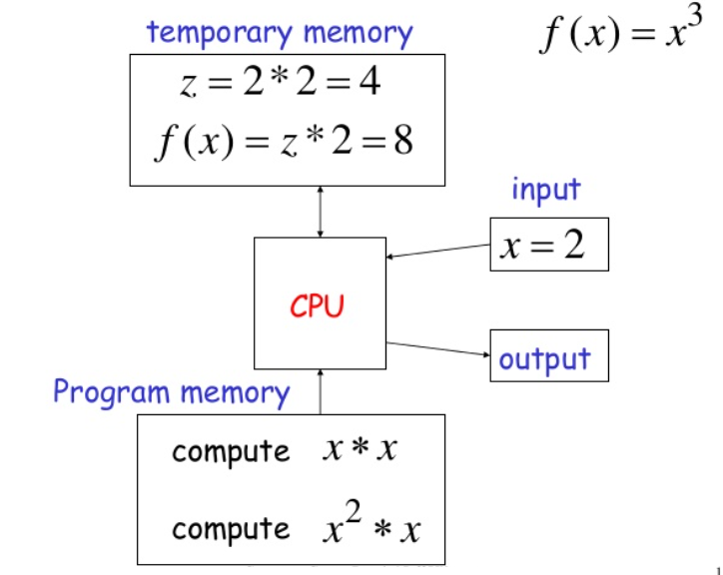

Slide 33
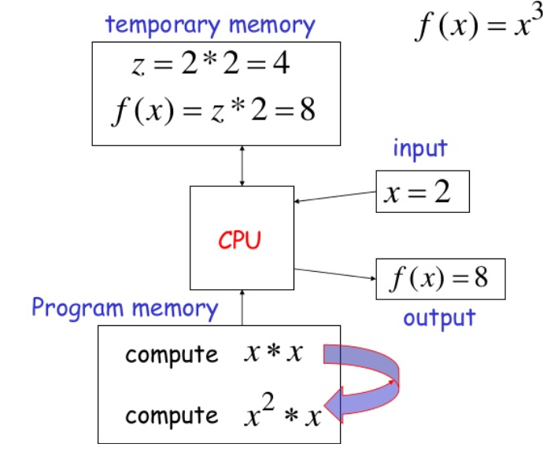

Slide 34
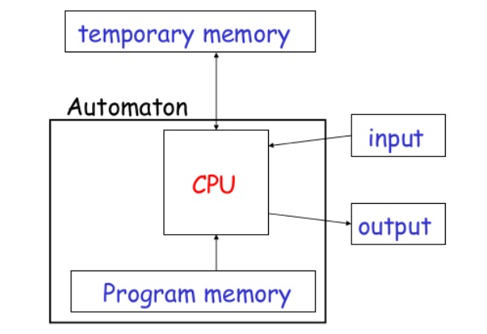
Automaton [IPO]

Slide 35
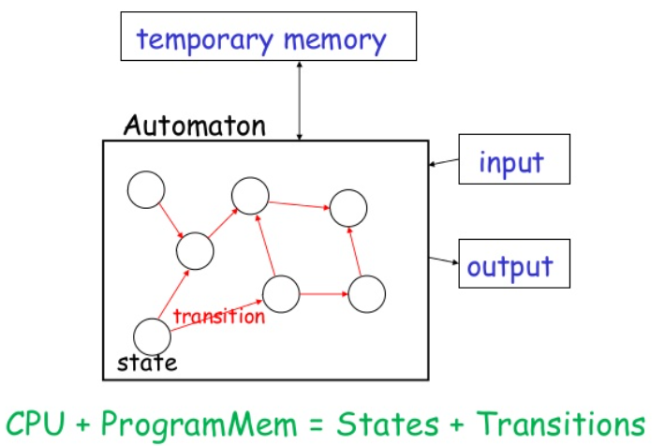
Automaton [Representation]

Slide 36
Different Kinds of Automata
Automata are distinguished by the temporary memory:
Finite Automata: no temporary memory
Pushdown Automata: stack
Turing Machines: random access memory

Slide 37
Memory VS Computational Power
Memory affects computational power:
More flexible memory
Results to
The solution of more computational problems

Slide 38
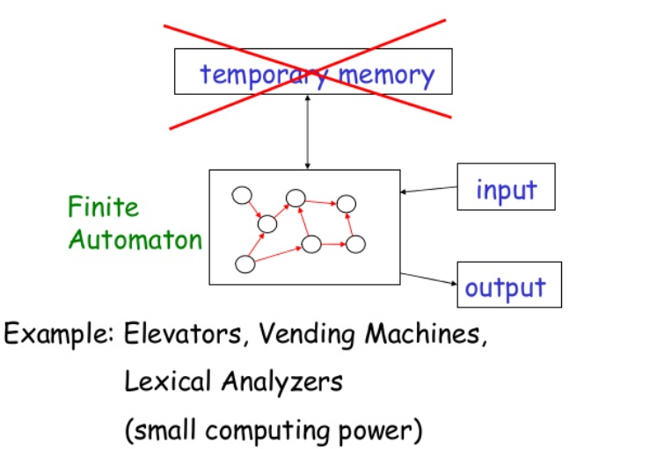
Finite Automaton

Slide 39
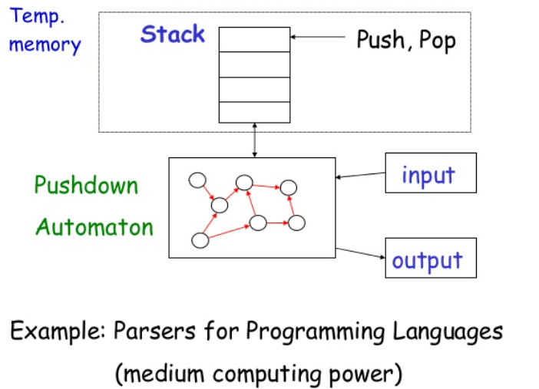
Pushdown Automaton

Slide 40
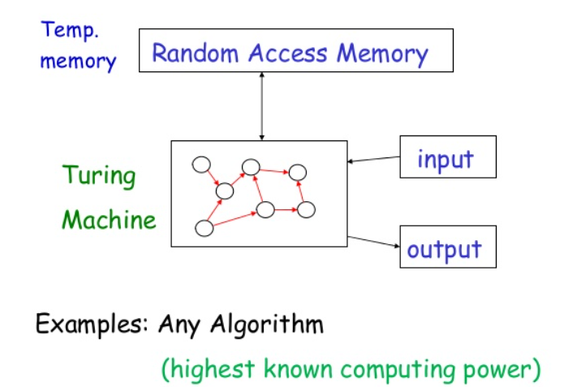
Turing Machine

Slide 41
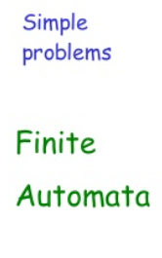
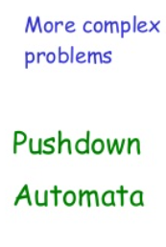
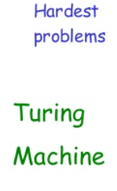

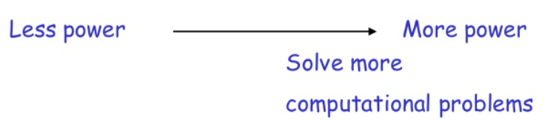
Power of Automata

Slide 42
Power of Automata (cont’d…)
Turing Machine is the most powerful known computational model
Question: can Turing Machines solve all computational problems?
Answer: NO
(there are unsolvable problems)

Slide 43
Summary
What is automata?
Why should study automata theory?
Importance of TOC
Applications of TOC
Power of automata

Slide 44
?
Questions

